Slide 1
World Wide Web (W.W.W)
Souptik Bhattacharjee, Roll - 260

Slide 2
Slide Content->
Introduction
History of the Web
Architecture of WWW
WWW Vs. Internet
Advantages of the Web
Limitations/Challenges of the Web
Some Key Facts
Conclusion

Slide 3
Introduction

Slide 4
Introduction…
The World Wide Web (WWW), often called the Web, is a system of interconnected webpages and information that you can access using the Internet. It was created to help people share and find information easily, using links that connect different pages together.
The Web allows us to browse websites, watch videos, shop online, and connect with others around the world through our computers and phones.
This data may be presented in the text, picture, audio, or video formats in the Internet.
Today, it connects the whole world’s population, making it one of the most powerful tools for communication and information sharing.

Slide 5
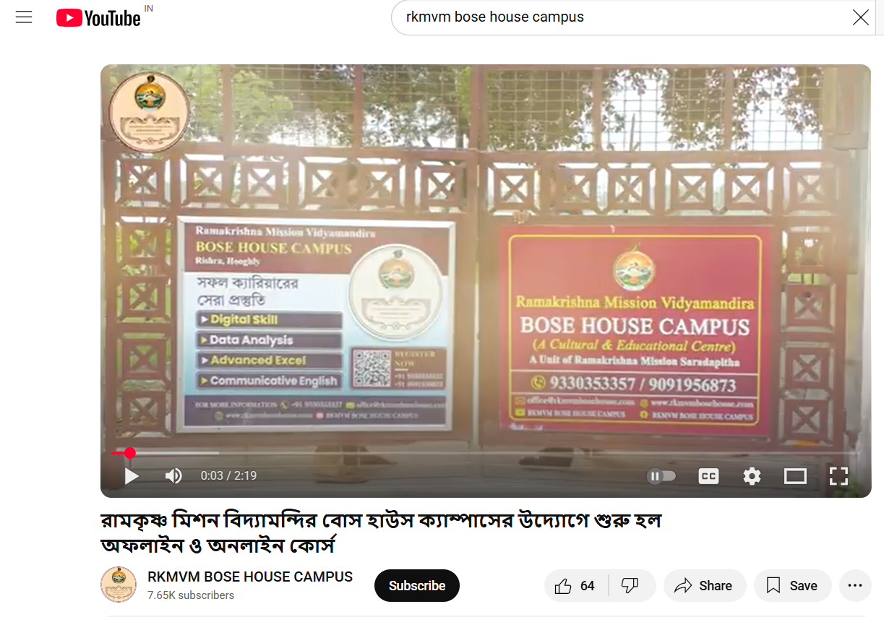
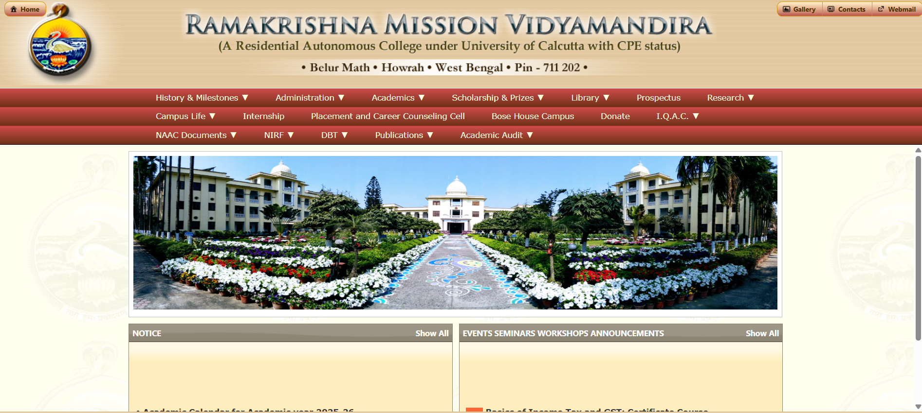
Watching Videos on Youtube
Browsing a Website
Example of Applications of Web

Slide 6
2. History of the Web

Slide 7
History of the Web…
It is a project created, by Tim Berner Lee in 1989, for researchers to work together effectively at CERN. It is an organization, named the World Wide Web Consortium(W3C), which was developed for further development of the web. This organization is directed by Tim Berners Lee, aka the father of the web. CERN, where Tim Berners worked, is a community of more than 1700 researchers from more than 100 countries. These researchers spend a little time on CERN and the rest of the time they work at their colleges and national research facilities in their home country, so there was a requirement for solid communication so that they can exchange data.

Slide 8
3. Architecture of WWW

Slide 9
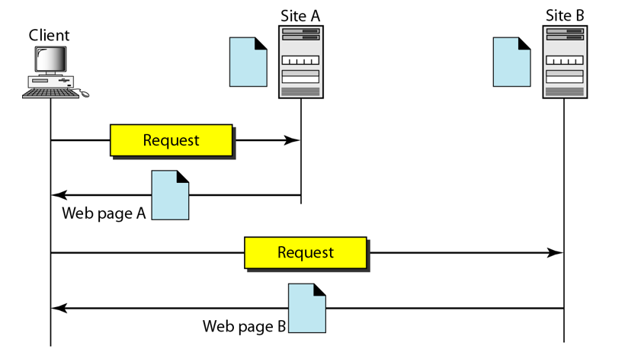

Slide 10
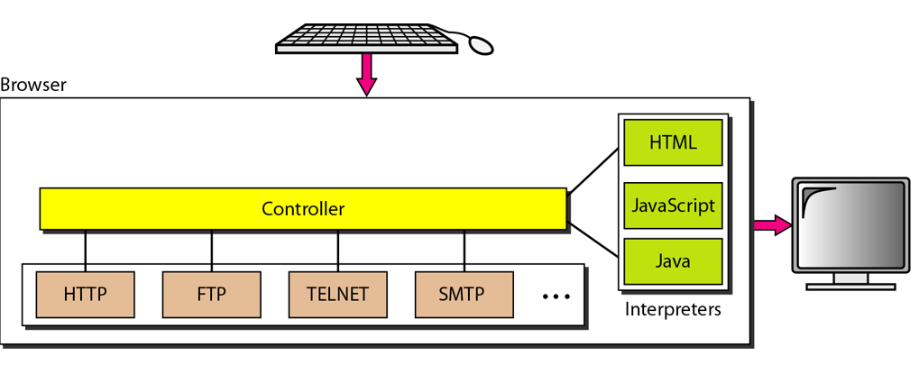

Slide 11
4. WWW Vs. Internet

Slide 12
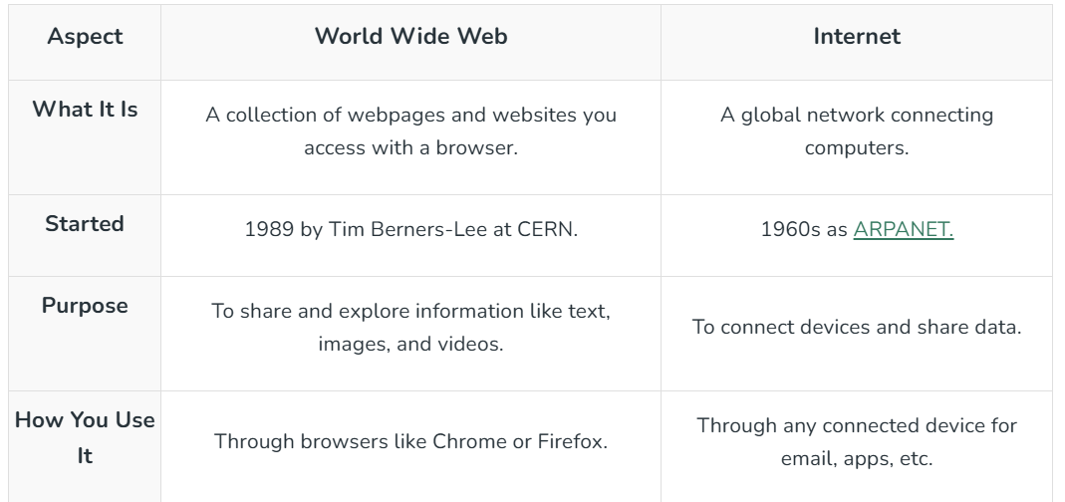

Slide 13
5. Advantages

Slide 14
Advantages…
Easy Access to Information Provides huge amounts of data on any topic, available 24×7 from anywhere in the world.
Global Communication Lets people connect instantly through email, messaging, video calls, and social media.
E-commerce & Online Services Enables online shopping, banking, ticket booking, bill payments, etc., saving time and effort.

Slide 15
Entertainment Gives access to movies, music, games, and live streaming.
Business Growth & Marketing Companies can promote products globally, reach more customers, and work with remote teams.
Collaboration & Sharing Tools like cloud storage, wikis, and online editors allow people to work together from different locations
Education & Research
Offers online courses, e-books, tutorials, and research papers, helping students and professionals learn easily.

Slide 16
6. Limitations/Challenges of the Web

Slide 17
Limitations…
Security & Privacy Issues
Personal data can be hacked or misused; cybercrimes like phishing, identity theft, and fraud are common.
Misinformation & Fake News
Anyone can publish content, so false or misleading information spreads easily.
Addiction & Time Wastage
Overuse of social media, gaming, or streaming may affect productivity and health.

Slide 18
Digital Divide Not everyone has equal access to the Internet (due to cost, infrastructure, or skills).
Viruses & Malware Downloading unsafe files or visiting harmful sites can damage devices.
Overload of Information Too much content makes it hard to filter reliable and relevant data.

Slide 19
7. Some key facts

Slide 20
Some key Facts…
The first website ever is still online! You can visit it at "http://info.cern.ch/"
There are over 1.5 billion websites in the world, and that number grows every day.
Google Chrome is used by more than 60% of people browsing the Web.
The Web is available in over 150 languages, so you can explore in your language or learn a new one!

Slide 21
8. Conclusion and Referrences

Slide 22
The World Wide Web is like a magical doorway to a world of knowledge, fun, and creativity. Since Tim Berners-Lee created it in 1989, it’s grown into something we use every day for school, games, and staying connected. By understanding how the Web works and using it safely, you can make the most of this incredible tool. So, grab your browser, explore, and have fun learning something new today!
References…. -
1)https://www.geeksforgeeks.org/computer-networks/world-wide-web-www/
2)www and HTTP(Chapter 27) - From Data Communications and Networking (4th Edition) - Behrouz A. Forouzan

Slide 23
Thanking you…

